Slide 1

European Partnership on Animal Health & Welfare (PAHW): organization
Hein Imberechts, Chair CWG AHW &
Jean-Charles Cavitte, Research Policy Officer, DG-AGRI
TC 25th of October 2021

Slide 2
Introduction to EUP and PAHW
JCC & HI

Slide 3

New approach to European Partnerships
New generation of objective-driven and more ambitious partnerships in support of agreed EU policy objectives
  Strategic orientation
  Simple architecture and toolbox
  Common set of criteria for the life-cycle (Horizon Europe regulation Article 8 and Annex III)
Key Features
Co-programmed
Based on Memoranda of Understanding/contractual arrangements; implemented independently by the partners and by Horizon Europe
Co-funded
Based on a joint programme agreed and implemented by partners; commitment of partners for financial and in-kind contributions
Institutionalised
Based on long-term dimension and need for high integration; partnerships based on Art 185/187 of TFEU and the EIT legal acts for 2021-2027
Notes:
How are we simplifying all this? For the first time in HE we will have a common set of key features that apply to all partnerships:
We will only have partnerships that will deliver on strategic orientations of HE. There needs to be evidence that a partnership is needed to achieve these objectives.
A common, simplified toolbox and architecture
A common set of rules when it come to the selection, implementation monitoring, following up and phasing out of partnerships
Under here we have the 3 types of partnerships, I will go through them in a minute. But here you can see them in increasing order of complexity.

Slide 4
Overview of 49 candidate European Partnerships
Pillar II - Global challenges & European industrial competitiveness
Pillar III - Innovative Europe
Cluster 1: Health
Cluster 4: Digital, Industry & Space
Cluster 5: Climate, Energy & Mobility
Cluster 6: Food, Bioeconomy, Agriculture, …
eit
support to innovation ecosystems
Innovative Health Initiative
Key Digital Technologies
Clean Hydrogen
Circular Bio-based Europe
InnoEnergy
Innovative SMEs
Global Health Partnership
Smart Networks & Services
Clean Aviation
Rescuing Biodiversity to Safeguard Life on Earth
Climate
Transformation of health systems
High Performance Computing
Single European Sky ATM Research 3
Climate Neutral, Sustainable & Productive Blue Economy
Digital
Chemicals risk assessment
Europe’s Rail
Food
European Metrology
(Art. 185)
Health
Connected and Automated Mobility (CCAM)
Water4All
ERA for Health
AI-Data-Robotics
Raw Materials
Animal Health & Welfare*
Rare diseases*
Photonics
Batteries
Manufacturing
Accelerating Farming Systems Transitions*
One-Health Anti Microbial Resistance*
Made in Europe
Zero-emission waterborne transport
Urban Mobility
Agriculture of Data*
Cultural and Creative Industries
Personalised Medicine*
Clean steel – low-carbon steelmaking
Zero-emission road transport
Safe & Sustainable Food System*
Pandemic Preparedness*
Co-funded or co-programmed
Processes4Planet
Built4People
Cross-Pillars II and III
Global competitive space systems**
Clean Energy Transition
European Open Science Cloud
Driving Urban Transitions
Institutionalised Partnerships (Art 185/7)
Institutionaised partnerships / EIT KICs
Co-Programmed
* Calls with opening dates in 2023-24
** Calls with opening dates not before 2022
Co-Funded
Notes:
This is the current list.
Future partnerships are highly relevant to the Commission priorities – the European Green Deal, a people-centred economy, the fit for the Digital Age, and a stronger Europe in the world.
The majority of proposed partnerships aim at accelerating transitions towards climate neutral and circular society and economy. Consequently, many candidates are to team up with the private sector to decarbonise energy, mobility and steel sectors, or with Member States to provide solutions for the protection and sustainable management of resources (e.g. water, soil, biodiversity).
Others aim at building greater resilience of Europe’s health care systems and industry, including by ensuring EU’s technological leadership and open strategic autonomy in critical areas, such as smart networks and services, AI, data and robotics, photonics, hydrogen and batteries.
Most of these will start in 2021/22
In health and food/bioeconomy there is a short list of 8 partnerships that will start in 2023/24, that is because of they build on ongoing initiatives (still running) or require more time because they are completely new partnerships.
All industry partnerships we expect to start in 2021/23, while those starting later are generally those involving MS as participating states.
This is a stable list, we don’t expect changes.

Slide 5
European partnerships: provisions
  Regulation
  Recitals 36 and 38
  Article 2.3 : definition 3
  Article 10
  - typology
  - conditions
  Article 15.3 and Annex IV: financial contributions under other programmes
  Annex III: Partnerships, with criteria for
  - Selection, Implementation, Monitoring,
  Evaluation, phasing-out and renewal
  Annex VI: areas for possible
  institutionalised European Partnerships (based on Article 187 and 185 TFEU)
  Specific Programme
  Article 6: Identification of co-funded and co-programmed partnerships in the Strategic Plan
  Strategic coordinating process for European Partnerships
  Impact assessment: annex 8-5
  In addition: Draft Criteria Framework for European Partnerships
  All provisions in a nutshell and additional Information: ERA-LEARN
Horizon Europe legal basis:
Framework Programme :
EP&Council Regulation (EU) 2021/695
Specific Programme:
Council Decision (EU) 2021/764

Slide 6
Common for all European Partnerships
Strategic orientation: Priorities are defined as part of the strategic planning of Horizon Europe;
Necessity test for European Partnerships, compared to traditional calls:
Directionality: based on agreed objectives and expected impacts that are underpinned by Strategic Research and Innovation Agendas / Roadmaps;
Additionality: commitments from partners to mobilise and contribute resources and investments;
Common set of criteria along their life-cycle, defined in the Horizon Europe regulation (and the draft criteria framework);
Union contribution: in principle, clearly defined at the outset for the full duration of the initiative.
➔ In their implementation and certain features they differ, with the co-programmed being the most simple to prepare and implement, and the institutionalised the most complex.

Slide 7
Co-funded European Partnership
  Relevant current actions: European Joint Programme and ERA-NET Cofund;
  Implementation: Member States design a common programme to be implemented under their responsibility. It pools national funding/resources with co-funding from the Union.
  Legal form: Grant Agreement (programme co-fund action) signed between a consortium of beneficiaries and the Commission;
  Who is partner (beneficiary) in the grant agreement?
    Legal entities that implement the activities and produce costs that are eligible under the grant agreement;
    Core of the consortium: Programme owners/managers (nominated by participating states);
    Others in addition.
  Calls and evaluations are organised centrally by the partnership; beneficiaries in selected projects are funded at national level (on the basis of rules agreed by partners) a
  Important to define ex-ante:
  Types of partners needed to form the partnerships (consortium);
  Stakeholders providing input (e.g. priority setting) ← role of ministries!
  Stakeholders and target groups that are addressed/ involved by the ctivities implemented.
Estimated EU contribution to the 16 co-funded partnerships: EUR 2.2 billion
Notes:
Co-funded partnerships will follow the principle of Integrated programme with distributed implementation.
What does it mean?
In this type of partnership, we will have a Grant agreement signed between the Commission and a consortium of beneficiaries. Typically those beneficiaries will be national funding agencies.
The recipients of the EU co-funding implement the initiative under their responsibility, with national funding/resources pooled to implement the programme with co-funding from the Union. In other words, EC funds are transferred to the network of funding agencies that will then launch the calls and activities, and finance them at national level.
Funding rate is 30% and can go to 50% if research activities are done by the consortium directly.
It is important to note that the applicants to these calls are funded on the basis on NATIONAL funding rules
It has to be clear from the beginning:
who the partners in the consortium will be,
a strong commitment from MS (commitment of resources, as those are long programmes), a strong role of ministries is important.
Differentiate between beneficiaries of the cofund but then the beneficiaries of the grants (cascade)

Slide 8
Co-funded European Partnerships - Key principles
EU co-funding is at a constant rate [typically 30%, in exceptional cases 50%] per grant agreement and is generated by eligible costs
Each consortium agrees internally on how the EU cofunding is best used / distributed internally (similar to ERA-NET Cofund / EJP Cofund actions in Horizon 2020)
Beneficiaries in selected projects are funded at national level (on the basis of rules agreed by partners).
To create eligible costs for co-funding, the financial management of co-funded European Partnerships will be in line with the rules for financial management for any Horizon Europe action.This applies to all contributions, including cash contributions (in Horizon 2020 they were listed under cost category financial support to third parties)
All Co-funded European Partnerships will have corresponding topics in the Horizon Europe work programme

Slide 9
Cash contributions
The partnership will need cash contributions from Member States (in addition to the EU contribution)
To be used for paying the grants to the research performers – following the partnership’s calls for proposals
Paying these grants is called “Providing financial support to third parties”

Slide 10
In-Kind Contributions
Any direct expenditure of a partner in the consortium (other than providing financial support to third parties) for activities of the partnership are, in principle, in-kind contributions
The coordination and management of a partnership could be an example of such an activity
If the partners perform R&D themselves, the man-hours are an in-kind contribution
Institutional funding of research performing or governmental organisations, if they are implementing R&I activities in the partnership, can also qualify as in-kind contribution

Slide 11
Beneficiaries which are receiving financial support to third party – Conflict of interest avoidance
In case a direct beneficiary to the signed co-funded Grant Agreement also applies to the calls (to third parties) organised by the partnership (i.e. a beneficiary is both research funder and research performer ):
Then, the consortium should implement all points below:
The consortium should identify the beneficiaries which might apply for funding under the co-funded call for proposals
The consortium should explain the measures taken or to introduce additional measures to mitigate the risk of, perception of, or de facto conflict of interest or unequal treatment of applicants
The consortium should reflect all these measures fully in their description of activities for the preparation and implementation of the co-funded call as well as in relation to the monitoring of the trans-national projects
These measures should be implemented by demonstrating that information is kept non-accessible to other members of the consortium (or the departments concerned, in case a beneficiary is both research funder and research performer) that might apply to the co-funded call
These measures should include a procedure, which ensures the independent and fair treatment of complaints related to the call, in particular for complaints relating to unequal treatment of applicants

Slide 12
Timeline CoF partnerships preparation for WP2023-2024
Partnership proposal
Draft by end Dec 2021 -> RTD review
Approved version January 2022
Commitment letters sent Jan/Feb 2022
SRIA
SRIA process start end 2021
SRIA finalised end 2022
Horizon Europe Work programme 23-24
Application & GAP
First draft Jan 2022
ISC ready version with topics mid-2022
Publication end 2022/ beginning 2023
Application by .. 2023
Grant by .. 2023-… 2024: SRIA to be adopted by partnership

Slide 13
Working Groups covering both AH & AW
WG Surveillance: Y Van der Stede (EFSA) and W van der Poel (EPIZONE)
WG Diagnostics: P Jokelainen (OHEJP) and M Beer (CWG)
WG Farming Practices: K Möller (ICRAD, farming) and V Michel (Animal Welfare)
WG Treatment & Vaccines: S Arnouts (Industry perspective) and A Morrow (IRC)
Plus transversal working groups
  WG AMR (see One Health EJP and JPIAMR): A Käsbohrer and
  R La Ragione (OHEJP)
  WG Fish (see SCAR Fish): M Bagni and G Arcangeli
  The outcomes should become included in the objectives of the other Working Groups
Notes:
HI: deleted ‘ (both fish) ’

Slide 14
EU Partnership AH&W, approach
Surveillance & Data
Knowledge development e.g. pathogens, vectors, immunology, welfare indicators
New technologies and ‘omics’
(Big) data, data management & -sharing
Standards
Good practices on animal health and welfare, biosecurity,
Wildlife
Antimicrobial Resistance, e.g. ATA
Diagnostics
Farm practices
Aim: to build a strong research and innovation framework strengthening Europe’s capacity to raise healthy animals with increased welfare standards
Treatments & Vaccines

Slide 15
What has to be done in 2021?
All WG describe their planned activities, based on the presentations given at the webinar with stakeholders (29 June 2021) and further discussions, following the intervention logic (from needs to impact)
Focus on Operational Objectives (OO)
  To discuss: SMART (specific, measurable, achievable, relevant, time-bound) activities/aims are needed, resources (incl. the actors), and possible indicators
  Deadline: end of October 2021
This work will give input to both the dossier and the SRIA
Needs
Input/re-sources
Activities
Delivera-bles/output
Outcome
Impact
PAHW Dossier
Webinar slides & disc.
‘Preparation PAHW WG’
PAHW SRIA
PAHW SRIA

Slide 16
What has to be done in 2021 and 2022?
Dossier PAHW for assessment by RTD and look for commitment by Member States
  Defining the ‘What’, the general and specific objectives seem to be commonly accepted, although indicators still have to be defined; deadline 25th of October
  Next, to detail the ‘How’: the organisation, governance, etc.
  PAHW dossier expected to submit to DG-RTD by the end of this year!
To draft the PAHW Strategic Research & Innovation Agenda (SRIA)
  To ensure that the long-term vision is translated into concrete roadmaps with smart objectives and related indicators
  Ongoing contacts and discussion with ICRAD, with DISCONTOOLS and with the
  One Health EJP, STAR-IDAZ IRC, etc. to join forces to develop the SRIA
  Deadline for an (advanced) draft of the PAHW SRIA: February-March 2022
Subsequently / in parallel: preparation of the PAHW proposal
  Call deadline likely by end 2022 or early 2023

Slide 17
PAHW Dossier: The What & The How
PAHW Dossier
Webinar slides & disc.
‘Preparation PAHW WG’
The What, content
  4 WG draft ‘Preparation PAHW dossier WG’
  This will feed into the PAHW Dossier + the SRIA
  CWG (+ Core Group) have been invited to comment on PAHW Dossier v3.0 (Teams) before 25 October
The How, organisation
  Interested parties (through survey following Stakeholders webinar of 29 June, Core Group, other contacts) have been invited to reflect on the PAHW organization; access PAHW Dossier v3.0 (Teams)
  First TC on 25 October
  An amended Core Group is needed
PAHW SRIA
PAHW SRIA
CWG AH&W
The What
The How
Interested parties

Slide 18
Societal: Vulnerable sector with low societal recognition
Technological: New technologies are available but expensive; opportunities for innovation exist but difficult to reach
Environmental: Variable external conditions (climate change, chemical contaminants incl. antimicrobials, etc.)
Economic: Sub-optimal investment; veterinary pharmaceutical sector is less profitable than in public health
Political: Animal health, welfare and food regulations at EU level, Tripartite Action Plan AMR, Green Deal, new CAP, etc. enforce rigid restrictions
DRIVERS
To reinforce the preparedness of all actors involved in animal health and animal welfare against animal infectious diseases
To place animal welfare at the foreground of livestock production
To enhance cross-sector collaboration to prevent the spill-over from animals, food and the environment to humans
GENERAL OBJECTIVES
To facilitate the cooperation between all animal health and welfare actors on the monitoring, prevention and treatment of animal infectious diseases
To boost research and to increase the evidence-base to develop products and tools for animal infectious disease and animal welfare monitoring and control
To strengthen the communication and dissemination of project outcomes to scientific, societal, political and private stakeholders
SPECIFIC OBJECTIVES
Surv. System animal health
Surv. System animal welfare
Support monito-ring animal health
Support monito-ring animal welfare
Risk Assess-ment animal health
Risk Assess-ment animal welfare
Preven-tion against AID on farm
Preven-tion regar-ding animal welfare on farm
Treat-ment of priority animal infec-tious diseases
Vaccines
Alterna-tives for anti-micro-bial use
Socio-econo-mic initia-tives
OO: under construction
OPERATIONAL OBJECTIVES

Slide 19
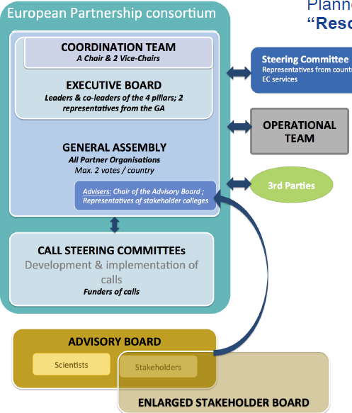
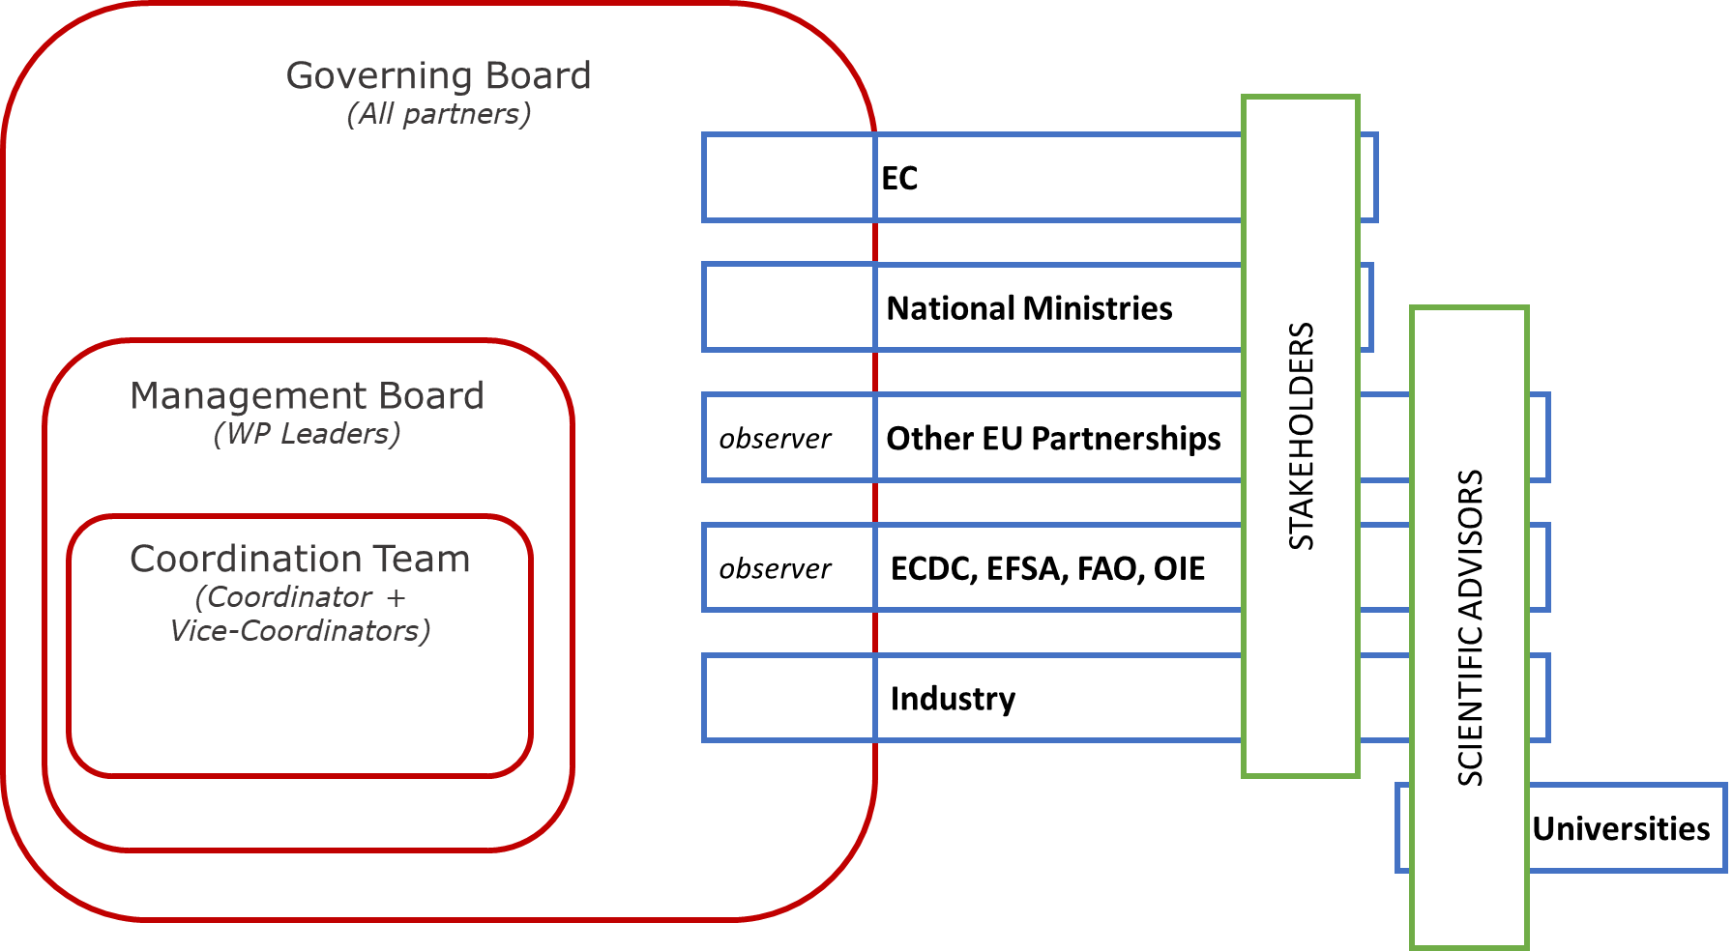
Possible Governance scheme
Under construction

Slide 20
Possible scenarios

Slide 21
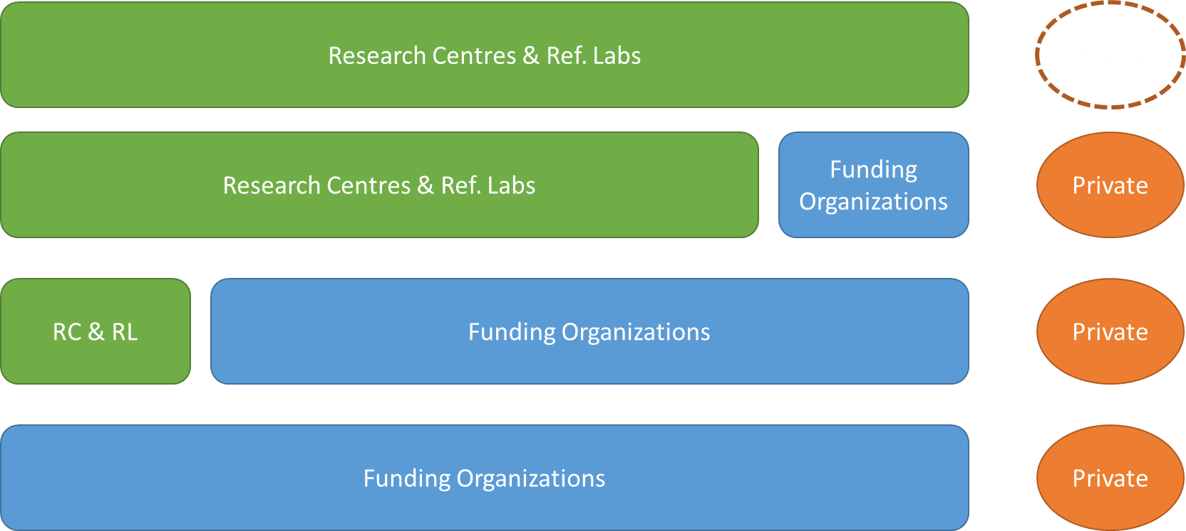
Possible approaches
Do all the work internally
(only research centres in the consortium, no funding organizations)
Do the majority of the work internally
(consortium with large number of research centres, plus funding organizations)
Do the majority of the work through external, open calls
(consortium with funding organizations and restricted number of research centres with specific reference activities)
Do all the work through external open calls
(consortium with essentially only funding organizations)

Slide 22
Do all the work internally
The only actors are public ref labs and research centres: essentially only in kind resources are used; no funding organizations (FO), no private partners, since no external calls
To focus on strengthening the network of public animal health & animal welfare actors
Only internal calls, all co-funded: possibility to request co-funding rate higher than 30% (see PARC 50%)
No conflict of interest
But: risk of restricted budget since no FO, research topics limited to expertise among research centres (unless using linked third parties), limited measurable uptake by private partners (as outside consortium activities)

Slide 23
Do the majority of the work internally
Actors are a (large) selection of public ref labs and research centres (internal calls, possibly in external calls, but possible conflict of interest), plus some FO, private partners and universities in external calls
Mainly internal calls, all co-funded; FO and third parties can join for external open calls on case by case basis (limited, thus maximising in kind contributions; possibility to request co-funding rate higher than 30%)
Enabling bigger budget (by maximizing in kind contributions)
But: difficult to define actors from the start for specific activities; manage conflict of interest

Slide 24
Do the majority of the work through external, open calls
Actors are mainly funding organizations, but also public ref labs and research centres; also private partners in certain calls
Both open and internal calls, with FO providing a large part in the funding (in cash) and restricted number of research centres doing activities internally
Likely co-funding at 30% (as work mainly with external calls), which may impinge both on internal and external activities
Management of conflict of interest (e.g. excluding public ref labs and research centres from external calls or from decision making process) might be easier than in option 2 as fewer research centres are in the consortium

Slide 25
Do all the work through external open calls
Actors are funding organizations and / or authorities, no public ref labs or research centres), only limited number of private partners
Co-funding 30%; likely difficult to get heavy in cash from countries
Only open calls, (most) co-funded; industry and third parties can join (open call) on case by case basis
Basically no risk of conflict of interest
But: likely more restrictred budget (in cash contributions)

Slide 26
Research Centres & Ref. Labs
Private
Research Centres & Ref. Labs
Funding Organizations
Private
RC & RL
Funding Organizations
Private
Funding Organizations
Private

Slide 27
From the EUP template
Template ‘Partnership Guidance’, Sept. 2019

Slide 28
3.1 Activities
Describe the envisaged portfolio of activities to support the full and effective achievement of the objectives and expected impacts of the proposed Partnership (to be elaborated in detail in the SRIA);
  Open calls, internal calls
  Consultations to identify needs of stakeholders
  Education and training activities, summer schools, scientific meetings and conferences for dedicated / larger audience
  Dissemination of results and outcomes: communication, dissemination, exploitation
  Policy meetings
  Other?

Slide 29
3.1 Activities
Describe the mechanisms which will ensure the complementarity of activities and help avoid unnecessary duplications with other relevant initiatives of Horizon Europe, including with other relevant European Partnerships, missions and EU actions / initiatives beyond Horizon Europe;
  Co-creating SRIA in collaboration with ICRAD ERA-Net, DISCONTOOLS, STAR-IDAZ IRC, One Health EJP, etc. (EPIZONE, others?)
  Contacts established with JPIAMR (EUP One Health-AMR), one of the consortiums preparing EUP Pandemic Preparedness, through SCAR with EUP Safe and Sustainable Food Systems, EUP AgroEcology, with EUP Biodiversity?
  Willingness to organize common calls for research

Slide 30
3.1 Activities
Demonstrate how the Partnership will ensure coherence and synergies in relation to major national (sectorial) policies, programmes and activities.
  Co-construction of PAHW dossier with DG-AGRI; links with SCAR
  All funding agencies / national & regional authorities for animal health and animal welfare will be invited as partners and can therefore contribute to make the inventory of appropriate, national policies, programmes and activities
  Links with private sectors: FVE, EATIP, COPA-COGECA,
  Links with relevant international organizations: EFSA, OIE, EMA?
  Links with industry: AnimalHealth Europe, Diagnostics for Animals

Slide 31
3.2 Resources
Please specify which types and levels of contributions from partners are necessary to achieve the objectives and impacts (financial contributions, in-kind contributions, activities/resources linked to market, regulatory, societal or policy uptake, broader investments) and provide qualitative and quantitative information on these;
  Can need to explain what 30% co-fund means in practice, knowing that e.g. 5 or 10% goes to overarching activities (meetings and events, recruitments, etc.)
  In cash trough FO, but also industry?
Please specify which other investments or framework conditions are envisaged / relevant for the deployment.
  Industry? Other private partners?

Slide 32
3.3 Governance
Outline the governance and management of the Partnership, including advisory structures and mechanism to be established. Demonstrate how the governance and management of the Partnership helps to achieve the defined vision and objectives. Describe how it will contribute to ensuring coherence and synergies with the EU research and innovation landscape and demonstrate, as well as transparency and openness during the Partnership as regards the identification of its objectives, priorities, vision, Strategic Research and Innovation Agenda (SRIA) and work programmes.
  Define actors/members and stakeholders
  Define roles of project manager, administrative team, incl. financial, monitoring, other?
  Scheme (coordinator + at least 2 co-coordinators)
  Avoid Conflict of Interest (who can take part in calls and get co-funding)
  Role of scientific advisors, stakeholders board (incl. other EUP representatives, EC DGs, international organizations), their composition

Slide 33
3.3 Governance
Provide, with the support of the Commission services supporting the preparation, a description of the involvement of the Commission in the preparation and implementation of the Partnership. In particular, describe the mechanisms for defining and defending the EU public interest in the framework of the Partnership.
  Role of the EC in Governing, as stakeholder

Slide 34
3.4 Openness and transparency
Demonstrate that the proposed Partnership will be established in a transparent way with no unjustified restriction in participation and with a broad, open and transparent approach towards different sectors and geographical areas including international partners when relevant. Justify any restrictions for the openness of the Partnership where it is deemed absolutely necessary;
Describe the strategies and plans throughout the lifetime of the Partnership to ensure easy and non-discriminatory access to information about the initiative and dissemination of and access to results (in line with Horizon Europe provisions), and to stimulate the participation of new partners and actors in the definition of common priorities and their participation in the partnerships itself or its activities (including eligibility for funding);
  Through the Annual Work Plan, active scanning of possible candidates, etc.

Slide 35
3.4 Openness and transparency
Describe how the proposed Partnership will establish a proactive recruitment policy which is dynamic and agile to allow a membership constituency responding to the evolution of the sector and the needs of the partnerships throughout its lifetime, across the Union and, where relevant beyond;
  At start: invitation of all funding organizations and resaedealing with animal health and animal welfare in Europe, as well as EFSA, OIE (and EMA)
Describe the process, during the implementation phase of the SRIA/roadmap, for establishing annual work programmes, and define measures to ensure and open and transparent methodology for consulting all constituent entities and relevant stakeholders for the identification of its priorities and the design of its activities.
  Alignment of SRIA (see above); meetings with stakeholders incl. industry; etc.

Slide 36
Next steps

Slide 37
Next steps
The What: Today deadline for CWG members to give feedback on
PAHW Dossier v3.0 on Teams
The How, sub-groups needed
  All to give feedback on the 4 scenarios
  All to give input to template, see attached document
  ‘Organization of PAHW Template’
    Sub-groups for drafting?
    Do you confirm you are available?
  Co-fund system, e.g. if 30% co-fund and €xM cost over-arching activities, what does this mean for co-fund activities?

Slide 38
Additional info

Slide 39
Open & Internal calls
 | Open calls | internal calls
Organizers | Funding organizations | Members of Consortium (research centres e.g. ref Labs, Ref centres and/or funding organizations)
Participants in calls | Ref Labs, Res centres, academic, industry | Members of consortium other than funding organisations; third parties
Type | Co-fund (or not), in cash | Co-fund, in kind
Themes most fit | High TRL | Low TRL
 | Unregulated domains | Regulated domains e.g. listed diseases; ref diagnostic methods; modelling
 | Domains of interest for industry (uptake) | Host-pathogen interactions
 | Technologies and diagnostics | Surveillance types
 | New technologies and treatments | Getting epidemiological data
 | Getting epidemiological data | Detection & characterization methods, harmonization
 |  | Risk assessment
 |  | Intervention: biosecurity and alike
 |  | Regulatory diseases, AMR major disease complexes

Slide 40
Potential members and stakeholders
being considered
Consortium members
European research centres working on infectious animal diseases and animal welfare
National and EU Reference Laboratories (Animal Health/AMR/Food safety) and Centres (Animal Welfare)
National and regional funding agencies
Stakeholders:
Universities
Relevant industry partners (animal sector, diagnostics & pharmaceutics)
Other relevant stakeholders: initiatives, agencies/authorities (e.g. EFSA, EMA, OIE..), advisory services

Slide 41
Eligible costs – conditions
No matter their nature, all costs have to comply with the Model Grant Agreement eligibility rules:
(i) they must be actually incurred by the beneficiary
(ii) they must be incurred in the period set out in Article 4 (with the exception of costs relating to the submission of the final periodic report, which may be incurred afterwards; see Article 21)
(iii) they must be declared under one of the budget categories set out in Article 6.2 and Annex 2
(iv) they must be incurred in connection with the action as described in Annex 1 and necessary for its implementation
(v) they must be identifiable and verifiable, in particular recorded in the beneficiary’s accounts in accordance with the accounting standards applicable in the country where the beneficiary is established and with the beneficiary’s usual cost accounting practices
(vi) they must comply with the applicable national law on taxes, labour and social security and
(vii) they must be reasonable, justified and must comply with the principle of sound financial management, in particular regarding economy and efficiency

Slide 42
Eligible Costs: what is new in Horizon Europe compared with Horizon 2020
Activities must be defined & agreed in the Annual Work Plan and the Grant Agreement
For the cost for financial support to third parties to be eligible, all call conditions need to be followed
Horizon 2020 cost categories | Horizon Europe cost categories
Unit costs | Unit costs
Financial Support to Third Parties | Direct costs A. Personnel costs B. Subcontracting costs C. Purchase costs C.1 Travel and subsistence C.2 Equipment C.3 Other goods, works and services D. Other cost categories D.1 Financial support to third parties
Indirect costs (reimbursed at the flat-rate of 25%, only applied to unit costs) | E. Indirect costs (reimbursed at the flat-rate of 25% of the eligible direct costs cat. A-C)
Certificate on Financial Statements | Certificate on Financial Statements

Slide 43
European Partnerships: monitoring criteria
A monitoring system in line with the requirements set out in Article 45 to track progress towards specific policy objectives, deliverables and key performance indicators allowing for an assessment over time of achievements, impacts and potential needs for corrective measures;
Periodic dedicated reporting on quantitative and qualitative leverage effects, including on committed and actually provided financial and in-kind contributions, visibility and positioning in the international context, impact on research and innovation related risks of private sector investments;
Detailed information on the evaluation process and results from all calls for proposals within partnerships, to be made available timely and accessible in a common e-database.
Source: https://data.consilium.europa.eu/doc/document/ST-7942-2019-INIT/en/pdf

Slide 44
State Aid rules and Projects funded under European Partnerships – new opportunity
Under the conditions specified in Articles 25c of the draft amendment to the General Block Exemption Regulation (GBER) and CPR 67.5, co-funded research and development projects may benefit from Horizon Europe eligible costs and funding rates.
No need to be subject to a separate State aid assessment and notification, it means:
  Transnational projects resulting from centrally organised calls for proposals;
  Horizon Europe funding rules apply (see Art 25c (3); the categories, maximum amounts and methods of calculation of eligible costs).
Horizon Europe rules apply to calls launched by Article 185/7 initiatives for those contributions that are managed centrally.
Otherwise, state aid rules apply to the contribution from Member States, in calls launched under programme co-fund actions → State aid at the level of the beneficiary, if the beneficiary is an undertaking.
Notes:
For the co-funded transnational calls, there are HE rules, clearly stated in the MGA. Specific rules for Co-funded Partnerships, pp 114. For the nationally signed grant agreements which result from the trans-national call, National rules.
! Advantage: National granting authority does not have need to reassess eligibility conditions – have already been assessed independently, at transnational call level prior to project selection, based on Horizon Europe rules
The categories, maximum amounts and methods of calculation of eligible costs shall be those defined as eligible under the Horizon 2020 or the Horizon Europe programme rules.
NB: Activities beyond TRL8 (‘experimental development’) are ineligible Transnational! Programme implemented by at least 3 Member States/alternatively 2 Member States + at least one associated country
30% Horizon Europe funding at programme level → same share to be ensured per project/per beneficiary
total public funding – i.e. all public national, local, regional and EU-centrally managed resources – per beneficiary/per project up to the funding rate established following independent selection, ranking and evaluation under Horizon Europe rules
CPR Art. 67(5)
For operations awarded a Seal of Excellence, or operations selected under a programme co-funded by Horizon Europe, the managing authority may decide to grant support from the ERDF or the ESF+ directly, provided that such operations meet the requirements set out in [points (a), (b) and (e) of paragraph 3]. [references still to be checked]
In addition, managing authorities may apply to the operations referred to in the first subparagraph the categories, maximum amounts and methods of calculation of eligible costs established under the relevant Union instrument

Slide 45
Building PAHW: state of play
Up to June 2019: discussion initiated with SCAR CWG AHW and early fiche developed by EC for consultation of Member States (AH only)
From Autumn 2019: mainly CWG AHW ‘Task Force’ meetings with AGRI + exploratory discussion with AHE, D4A; extension to AW
May 2020: preliminary dossier drafted by CWG AHW TF and AGRI, in consultation with EC services, AHE&D4A
  circulated to CWG AHW, National contact persons designated in 2019, EC services
  submitted to RTD (Unit Partnerships for early review)
Feb/March 2021: Setting up of 4 expert working groups to work on ‘what’: Surveillance, Diagnostics, Farm management, Vaccines and Treatment (+ AMR; Fish)
March 2021: publication of HE Strategic Plan 2021-2024: PAHW in the list of candidate European Partnerships
From June 2021: EC Webinar; establishment of extended Core-Group to work on ‘How’ ; reflection on SRIA development

Slide 46
Useful sources of information
European partnerships webpage on europa.eu:
European Partnerships in Horizon Europe | European Commission (europa.eu)
Partnership proposals
Report on coherence and synergies
Infographics
www.era-learn.eu
Contains a large variety of detailed information on the financial management of European partnerships, guidelines on SRIA development, etc.
3. Horizon Europe Strategic Plan
Identification of Co-programmed and Co-funded European partnerships

